Slide 1
Tri State Real Estate investment project
By Jason Hart
Prof Abhineet Kulkarni

Slide 2


Business Problem
We are working for a Real Estate Investment company looking to decide which metro area market they will invest in
The Firm is located in Princeton, NJ, so we will be looking at the Data from the Tri state area or PA, NJ and NY
We will be looking at the ROI and risk involved in the Metro area
This Photo by Unknown Author is licensed under CC BY-NC-ND

Slide 3
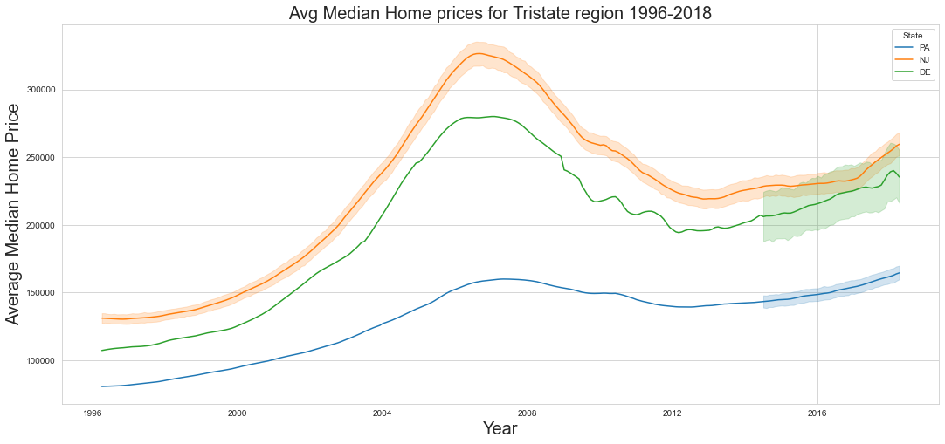

Data set
Data set contains monthly records of home sales data from 1996 till 2018
We will be running projections of ROI until 2021

Slide 4
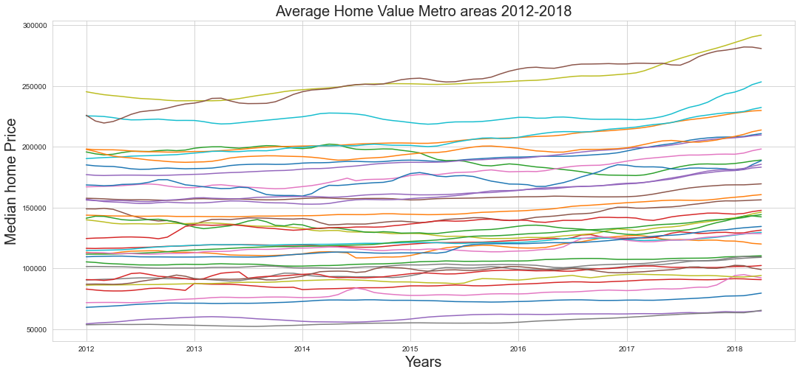

Slide 5
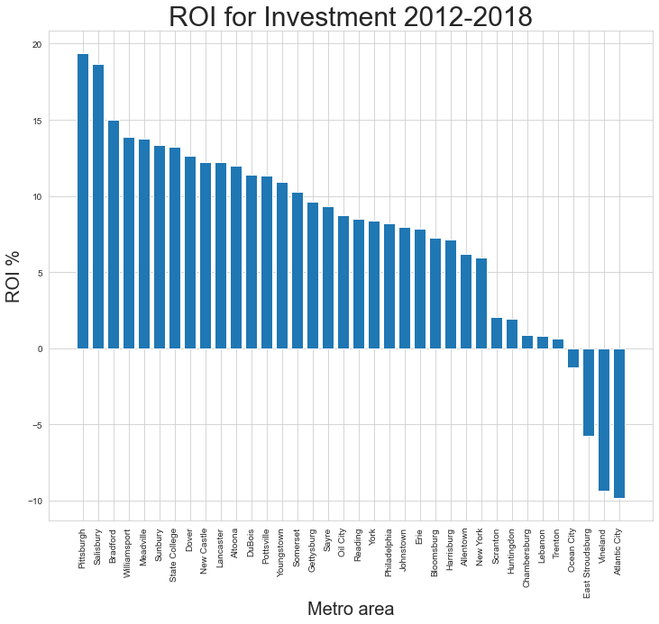
ROI from 2012-2018

Slide 6
3yr predictions for best investment

Slide 7
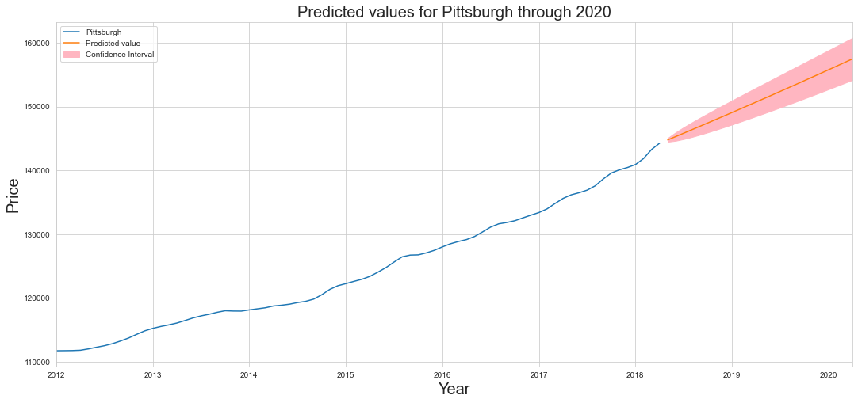

Slide 8
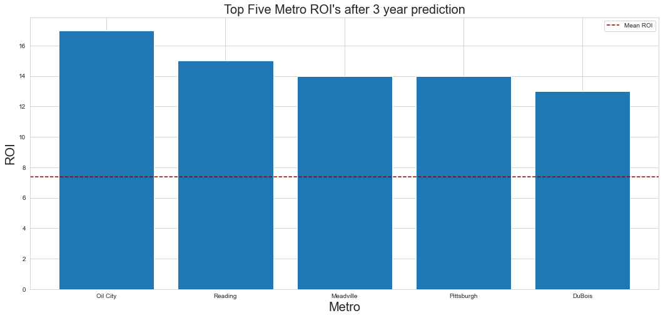

Slide 9
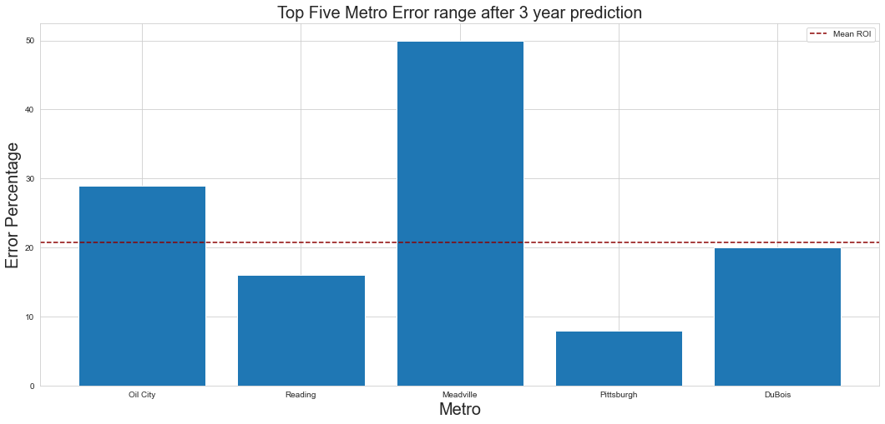

Slide 10

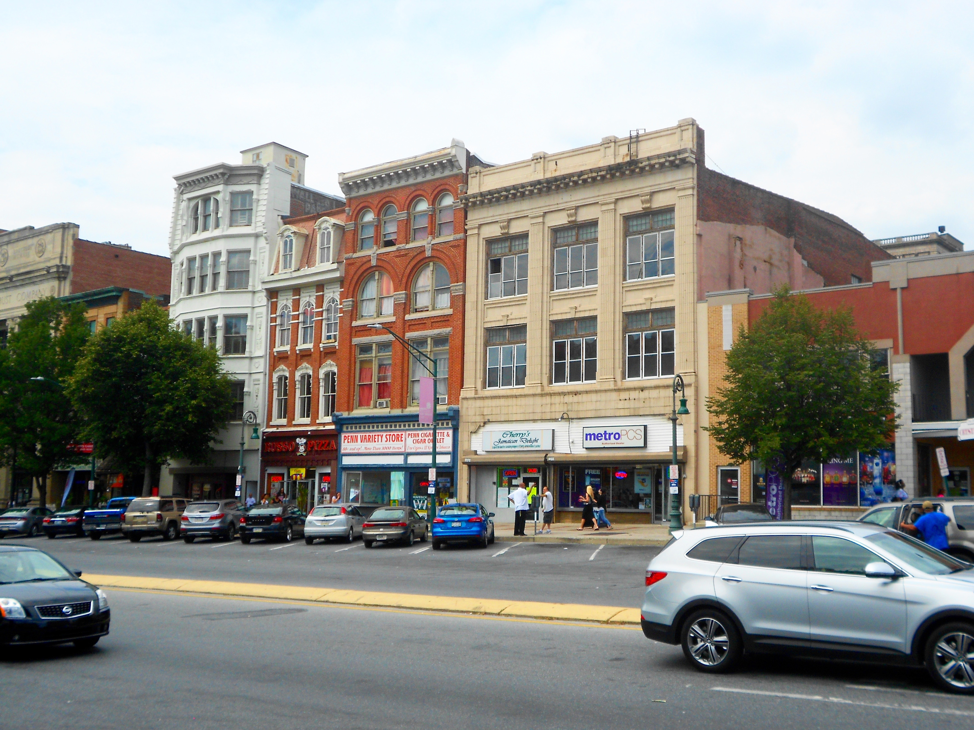
The Winners are
This Photo by Unknown Author is licensed under CC BY-NC-ND

Slide 11
Any Questions
Jason Hart
jasonmhart76@gmail.com

Slide 12
Next Steps
Break down data set into smaller areas of the two Metros and define exactly where to buy
Increase the number of States involved to see if we can increase ROI while decreasing risk by expanding our search
Investigate whether or not increasing our maximum initial investment will increase the potential for higher ROI

